Slide 1
GGPLOT2
Presenter: Quan Pham

Slide 2
Content
Introduction
Barplot
Histogram
Boxplot – Violinplot - Beanplot
Scatterplot
Take home messages

Slide 3
INTRODUCTION

Slide 4
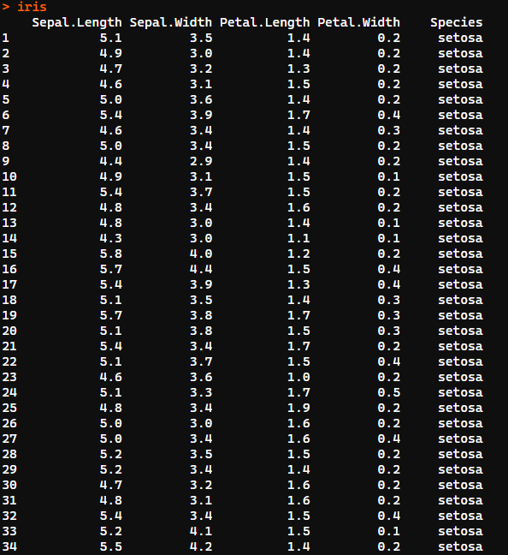
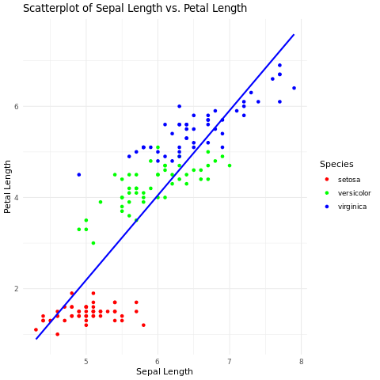
Why we need to visualize data?

Slide 5
ggplot2
ggplot2 is an R package for producing statistical, or data, graphics.
easy to learn: there is a simple set of core principles and there are very few special cases.
provides beautiful, hassle-free plots
Install.packages(“ggplot2”)
Library(ggplot2)
Notes:
aes(), describing how variables in the data are mapped to visual properties (aesthetics) of the plot, such as x and y coordinates, colors, shapes, etc.
bổ sung thêm hình vào các slide, chia ra

Slide 6
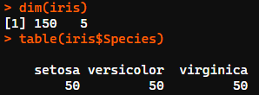
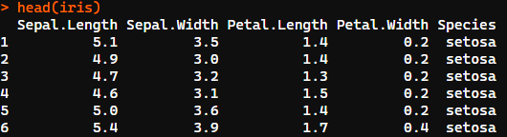
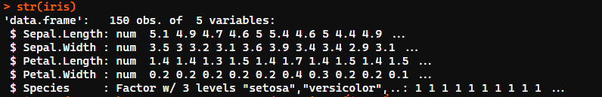
Data using
Library(datasets)
iris

Slide 7
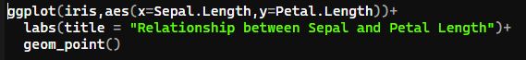
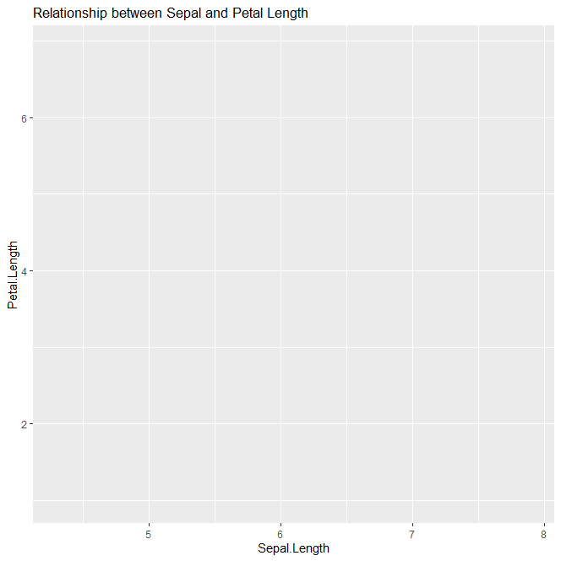
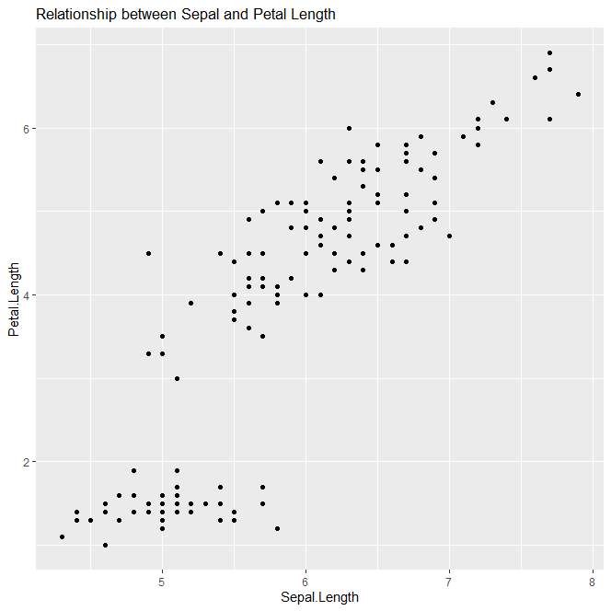
Syntax of ggplot2
ggplot(data, aes(x,y) + labs(title,xlab,ylab)
Notes:
+ data: The data frame containing the data to be plotted
+ aes(x,y): describing how variables in the data are mapped to visual properties (aesthetics) of the plot, such as x and y coordinates, colors, shapes, etc.
+ geom_<GEOM_FUNCTION>: used for creating complex plots; represents a type of geometric object that can be added to a plot, such as points, lines, bars, etc.
+ labs: used for adding title of chart, name of axis

Slide 8
ggplot(data, aes(x,y) +
Geom_function(<geom_options>)
stat_function(<stat_options>)
coordinate_function(<coordinate_options>)
facet_function(<facet_options>)
scale_function(<scale_options>)
theme_function(<theme_options>)
annotation_function(<annotation_options>)

Slide 9
Geom_function: define the type of geometric object to draw on the plot.
geom_point(): Scatter plot
geom_line(): Line plot
geom_bar(): Bar plot
geom_histogram(): Histogram
geom_boxplot(): Box plot
Geom_violin(): Violin plot
geom_density(): Density plot
geom_smooth(): Add a smoothed line (e.g., regression line)
Notes:
geom_point(): Scatter plot
geom_line(): Line plot
geom_bar(): Bar plot
geom_histogram(): Histogram
geom_boxplot(): Box plot
geom_density(): Density plot
geom_smooth(): Add a smoothed line (e.g., regression line).

Slide 10
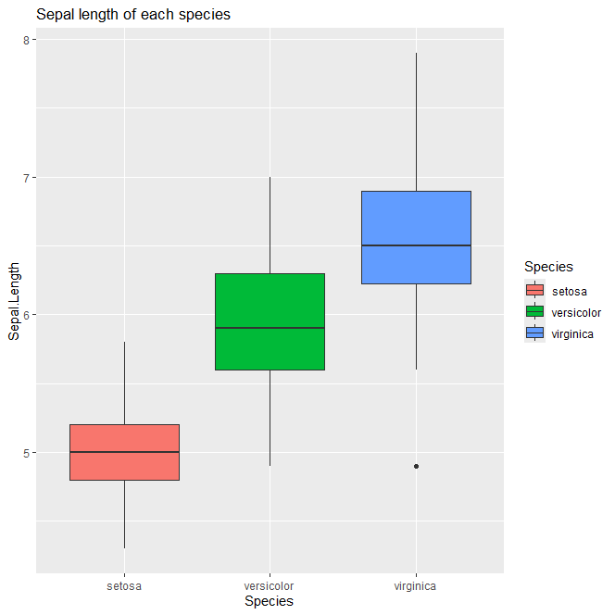
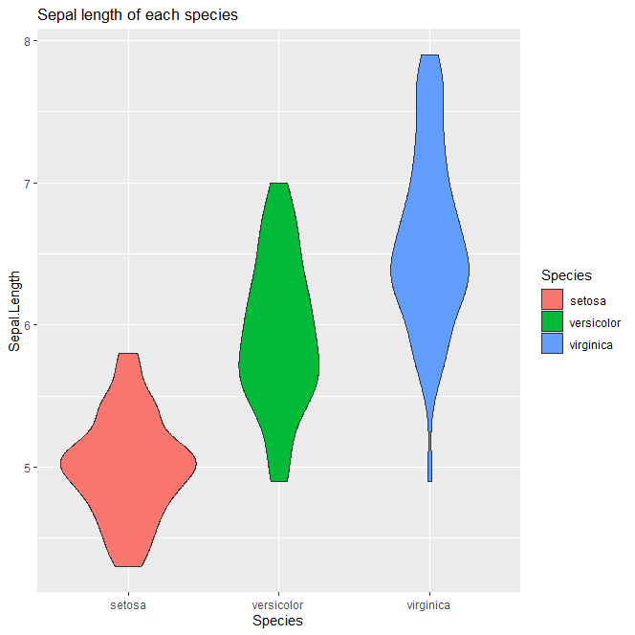
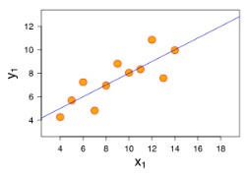
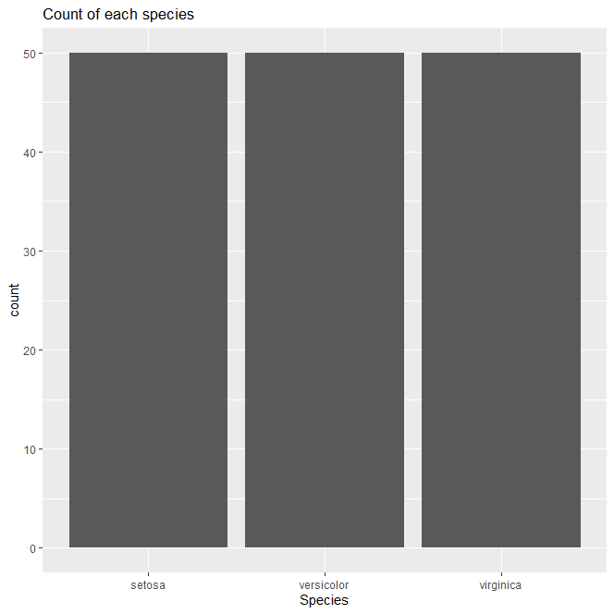
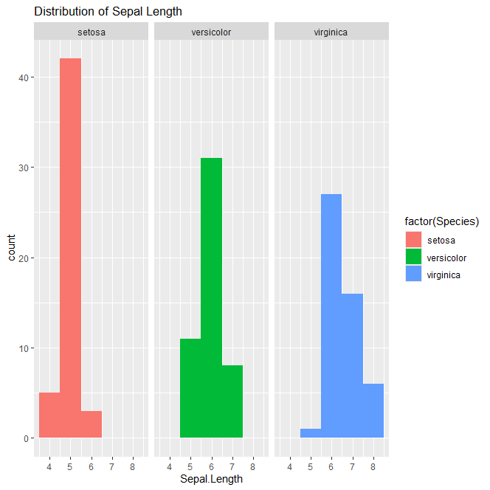
geom_boxplot(): boxplot
geom_violint(): violinplot
geom_point(): Scatter plot
geom_bar(): Bar plot
geom_histogram(): Histogram

Slide 11
coordinate_function: displays coordinate system
coord_cartesian(xlim,ylim): Sets the Cartesian coordinate system limits.
coord_flip(xlim,ylim): Flips x and y axes.

Slide 12
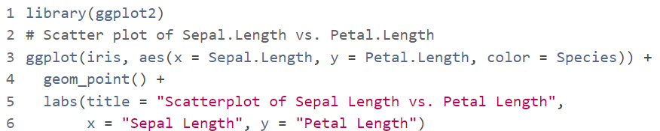
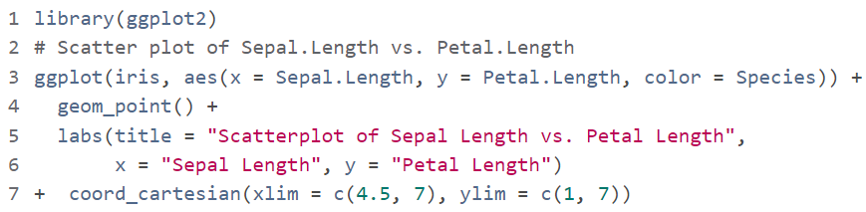
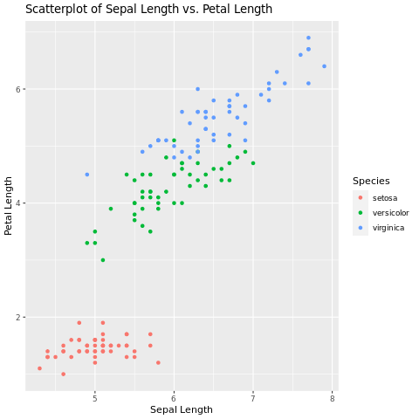
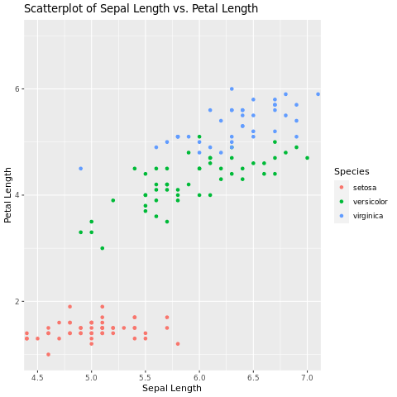

Slide 13
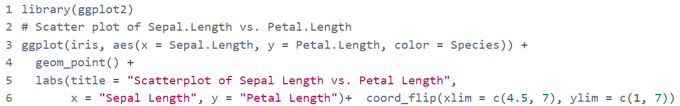
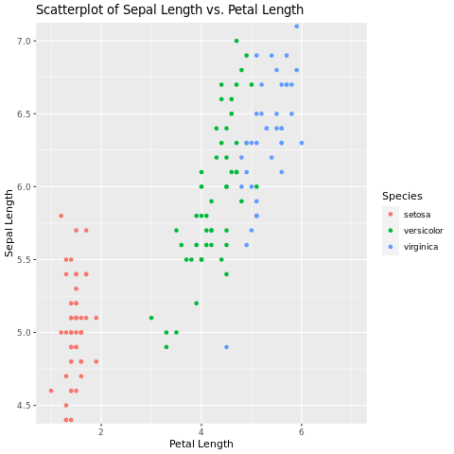

Slide 14
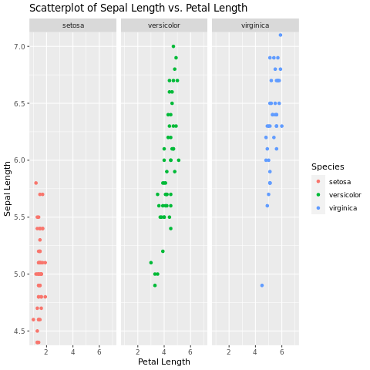
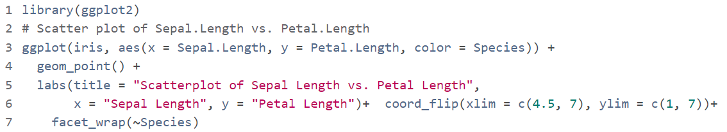
facet_function: create small multiples (faceted plots) based on categorical variables.
Notes:
coord_cartesian(): Sets the Cartesian coordinate system limits.
coord_flip(): Flips x and y axes.

Slide 15
Stat_function: displays statiscal on plot
geom_smooth(): Fits a statistical model (like a regression line) to the data.
stat_summary(): Computes summary statistics (e.g., mean, median) for subsets of data
Notes:
geom_smooth(): Fits a statistical model (like a regression line) to the data.
stat_summary(): Computes summary statistics (e.g., mean, median) for subsets of data

Slide 16
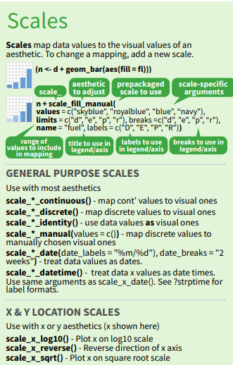
scale_function: adjusting the mapping of data values to aesthetics like color, size, or shape in a plot
Notes:
coord_cartesian(): Sets the Cartesian coordinate system limits.
coord_flip(): Flips x and y axes.

Slide 17
# Basic scatter plot with default scaling
p1 <- ggplot(iris, aes(x = Sepal.Length, y = Petal.Length, color = Species)) + geom_point() + labs(title = "Default Scaling")
# Example of manual scaling
p2 <- ggplot(iris, aes(x = Sepal.Length, y = Petal.Length, color = Species)) + geom_point() + scale_color_manual(values = c("setosa" = "blue", "versicolor" = "green", "virginica" = "red")) + labs(title = "Manual Scaling")
# Example of continuous scaling
p3 <- ggplot(iris, aes(x = Sepal.Length, y = Petal.Length, color = Sepal.Width)) + geom_point() + scale_color_continuous(name = "Sepal Width") + labs(title = "Continuous Scaling")
# Example of logarithmic scaling
p4 <- ggplot(iris, aes(x = Sepal.Length, y = Petal.Length, color = Petal.Width)) + geom_point() + scale_color_log10(name = "Petal Width") + labs(title = "Logarithmic Scaling")
library(gridExtra)
grid.arrange(p1, p2, p3, p4, nrow = 2)

Slide 18
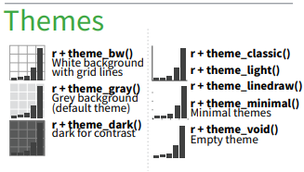
Theme_function: customize the appearance of plots
Notes:
+ data: The data frame containing the data to be plotted
+ aes(x,y): describing how variables in the data are mapped to visual properties (aesthetics) of the plot, such as x and y coordinates, colors, shapes, etc.
+ geom_<GEOM_FUNCTION>: used for creating complex plots; represents a type of geometric object that can be added to a plot, such as points, lines, bars, etc.
+ labs: used for adding title of chart, name of axis

Slide 19
BARPLOT

Slide 20
Usage: compare the frequency or count of categorical variables
Syntax: ggplot(data, aes(x))+geom_bar()

Slide 21
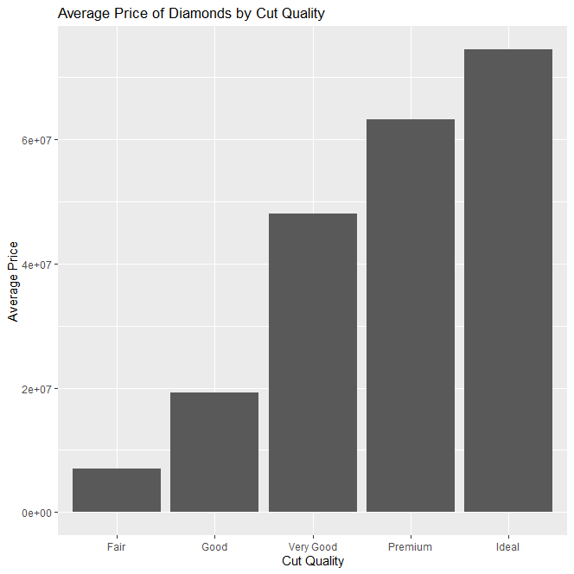
Component and Interpreting a Bar Plot
Title
Bars
Y-axis
X-Axis

Slide 22
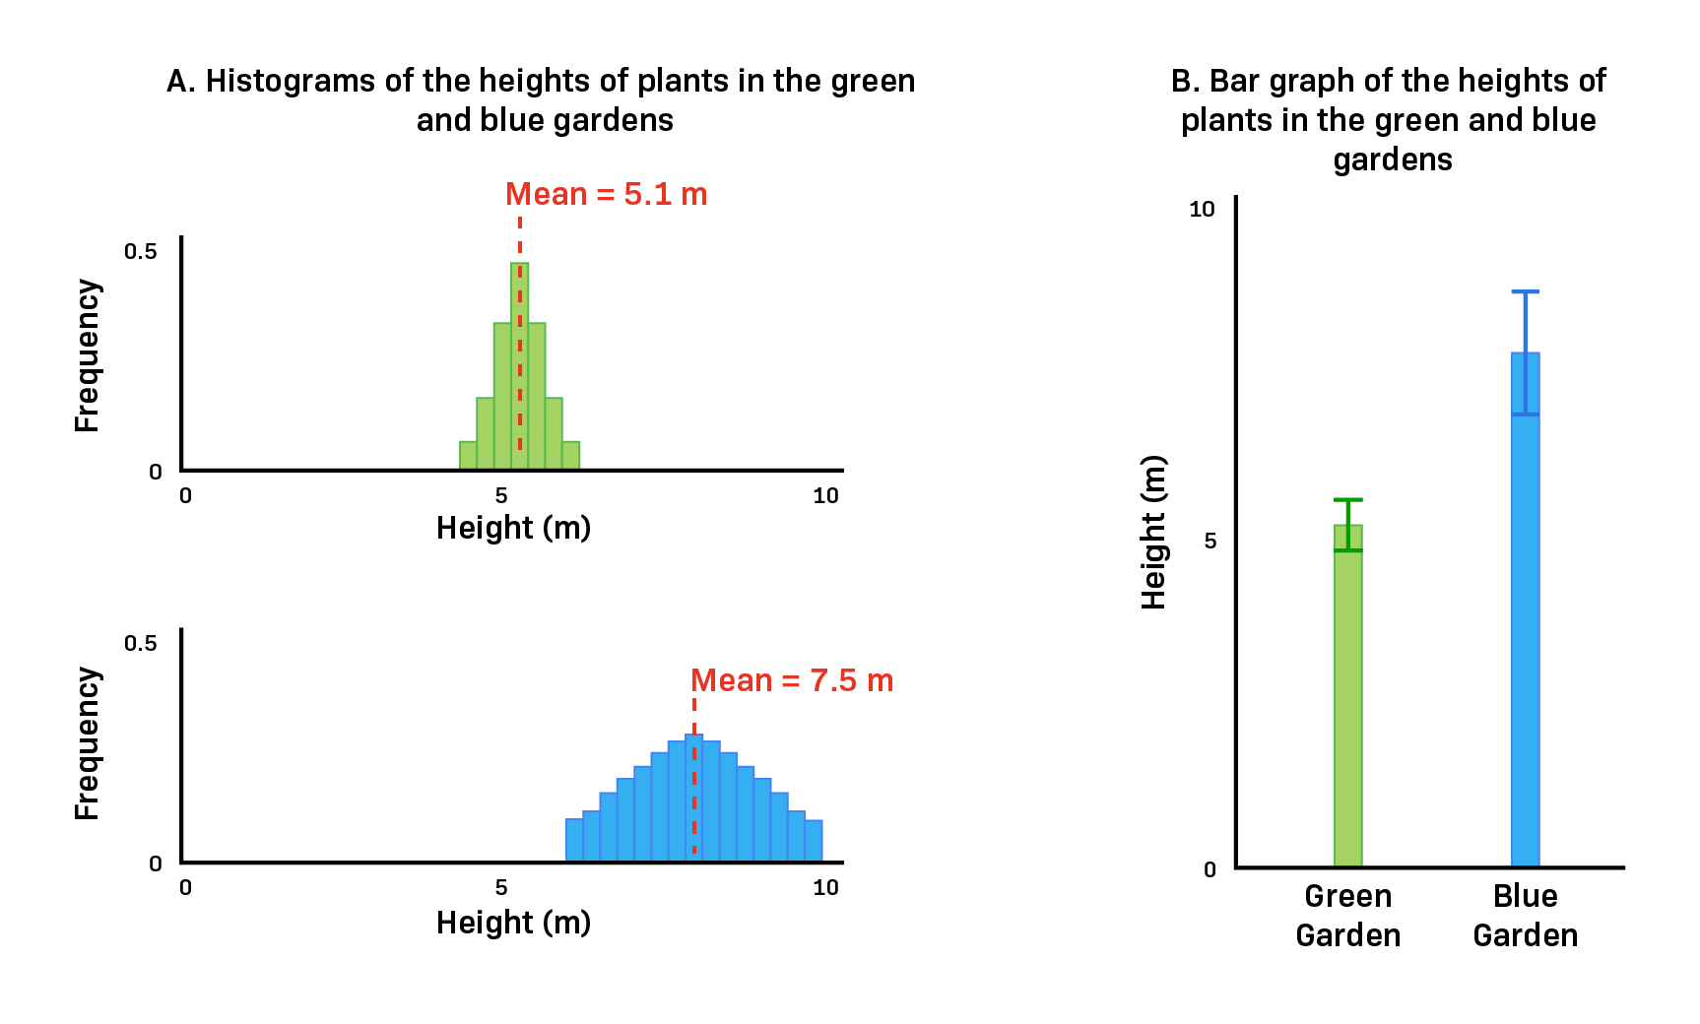
Advantages
BarPLOTS are useful for identifying the mean of a data set.
BarPLOTS can be used to compare data sets
Notes:
Barplot cho biết mean và SD
https://www.labxchange.org/library/items/lb:LabXchange:e034541a:html:1

Slide 23
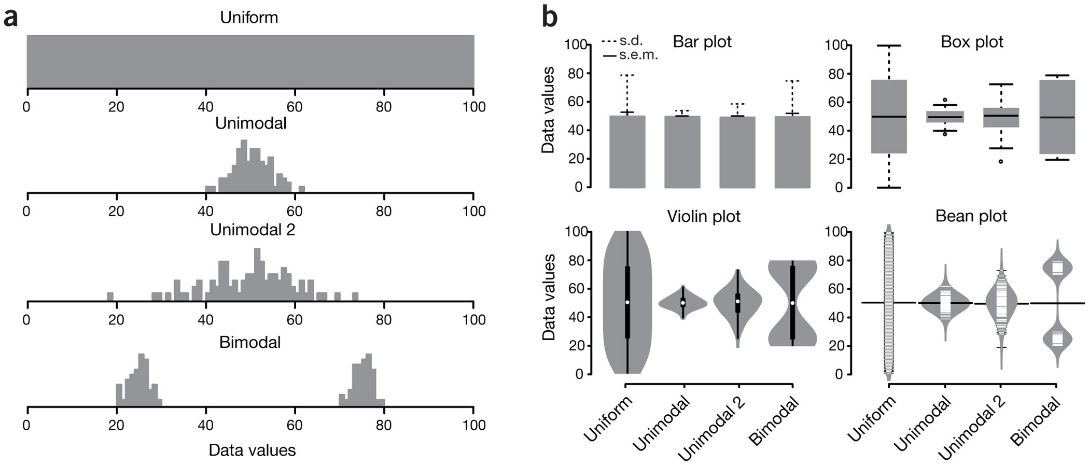
Disadvantages
Barplot summarizes mean and sd values
does not show the data distribution or sample size
Notes:
https://www.nature.com/articles/nmeth.2811/figures/1

Slide 24
HISTOGRAM

Slide 25
Usage: check the shape of the data distribution (normal distribution or not)
Syntax: ggplot(data, aes(x = <CONTINUOUS_VAR>)) + geom_histogram(binwidth = <BINWIDTH>)
Notes:
Displays the distribution of a single continuous variable/ show frequency distribution
When to Use Histogram?
The histogram graph is used under certain conditions. They are:
The data should be numerical.
A histogram is used to check the shape of the data distribution.
Used to check whether the process changes from one period to another.
Used to determine whether the output is different when it involves two or more processes.
Used to analyse whether the given process meets the customer requirements.

Slide 26
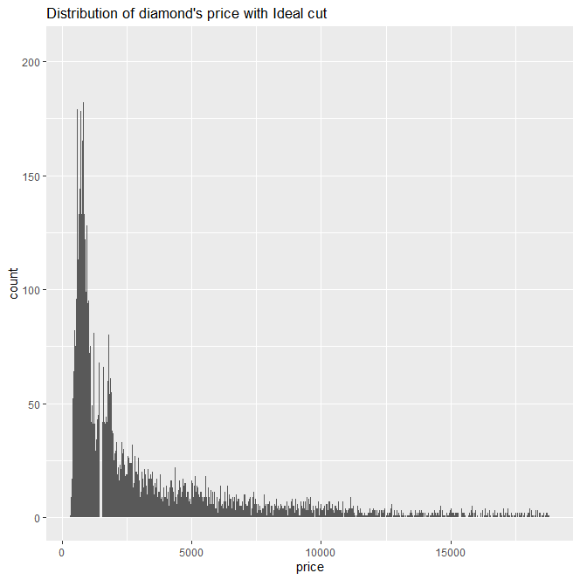
Components and interpret of a Histogram

Slide 27
Notes:
ggplot(mtcars, aes(x = wt, y = mpg)) + geom_point() + labs(title = "Scatter Plot of MPG vs Weight", x = "Weight (1000 lbs)", y = "Miles per Gallon")

Slide 28
Advantages
+provides an insightful look at frequency distribution such as the presence of multiple peaks, skewness, or gaps.
+Easy interpretation

Slide 29
Disadvantages
+ Bin selection
+ cannot read exact values because data is grouped into categories
+ Comparing two data sets is more challenging.
+ Only use this method with continuous data.
Notes:
Barplot cho biết mean và SD
https://www.labxchange.org/library/items/lb:LabXchange:e034541a:html:1
histograms are great for visualizing the distribution of a single dataset, they are less effective for comparing two datasets due to overlapping bins, scale differences, and binwidth issues.

Slide 30
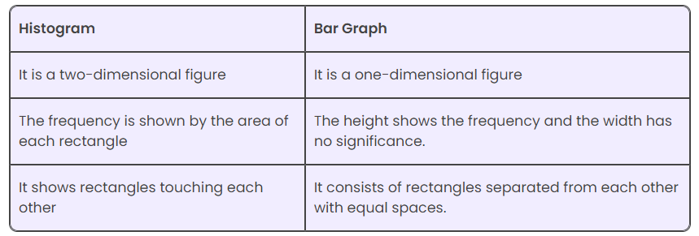
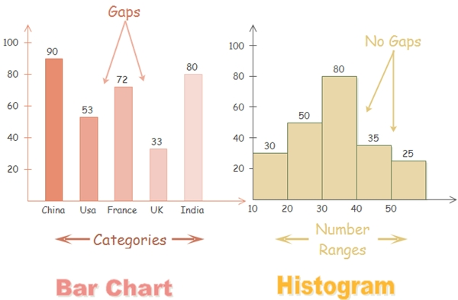
Compare Barplot and Histogram
https://byjus.com/maths/histogram/#:~:text=A%20histogram%20is%20used%20to,process%20meets%20the%20customer%20requirements.
https://getnave.com/blog/histogram-diagram/
Notes:
Axes:
X-axis (Horizontal Axis): Represents the categories or groups being compared.
Y-axis (Vertical Axis): Represents the numerical values or frequency counts of the categories.
Bars:
Each bar represents a category and its height (or length, in the case of a horizontal bar plot) indicates the value associated with that category.
Labels:
Category Labels: Positioned along the x-axis or y-axis to identify each category.
Value Labels: Sometimes bars are labeled with their exact values to make interpretation easier.
Title and Axis Titles:
The plot title explains what the bar plot represents.
Axis titles indicate what each axis measures.

Slide 31
BOXPLOT-VIOLINPLOT-BEANPLOT

Slide 32
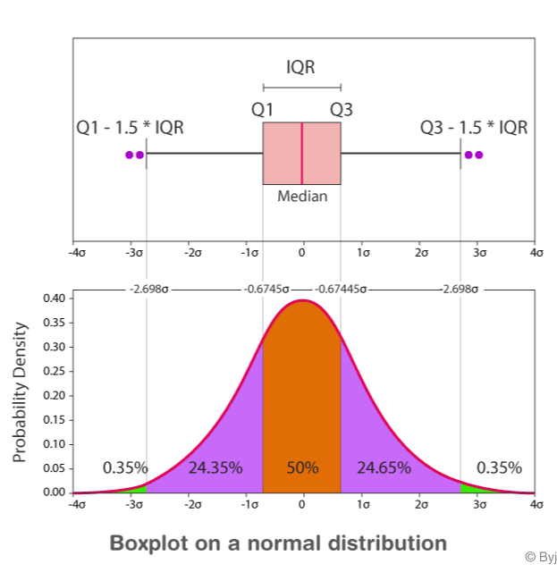
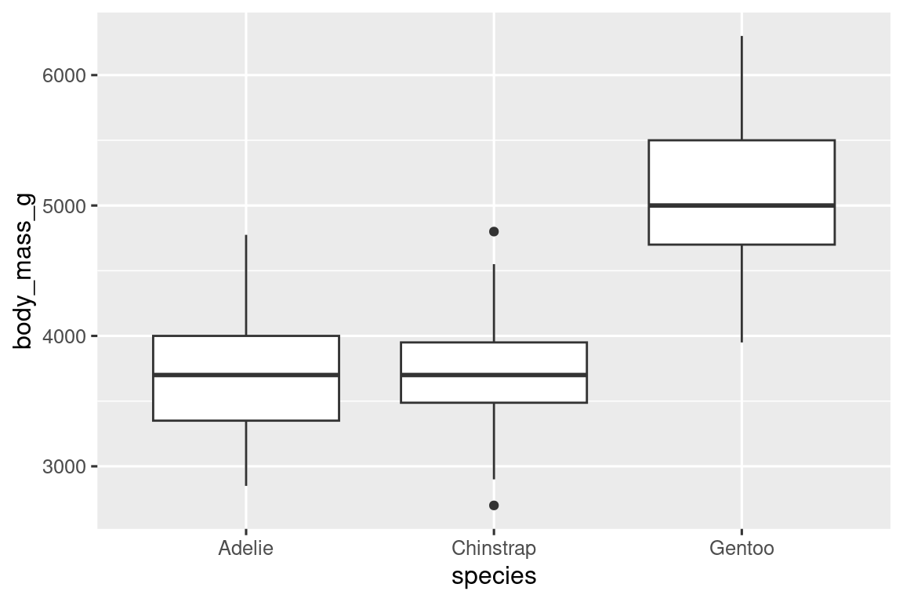
Components and Interpreting a Box Plot
https://byjus.com/maths/box-plot/
Notes:
https://quantgirl.blog/anatomy-of-a-box-plot/
Data points have to go above or below the box pretty far to count as outliers. How far? 1.5 times the size of the box.

Slide 33
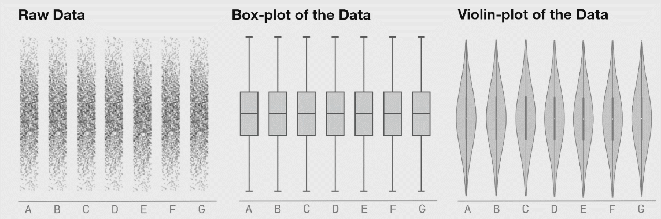

Slide 34
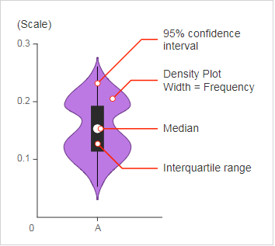
Components of a Violin Plot – Bean Plot
https://www.infinityinsight.com/blog/?p=357
Notes:
The dot in the middle is the median. The box presents interquartile range. The whiskers show 95% confidence interval. The shape of the violin display frequencies of values
the thicker part means the values in that section of the violin has higher frequency, and the thinner part implies lower frequency.
The “violin” shape of a violin plot comes from the data’s density plot. You just turn that density plot sideway and put it on both sides of the box plot, mirroring each other
https://blog.bioturing.com/2018/05/16/5-reasons-you-should-use-a-violin-graph/
https://www.atlassian.com/data/charts/violin-plot-complete-guide

Slide 35
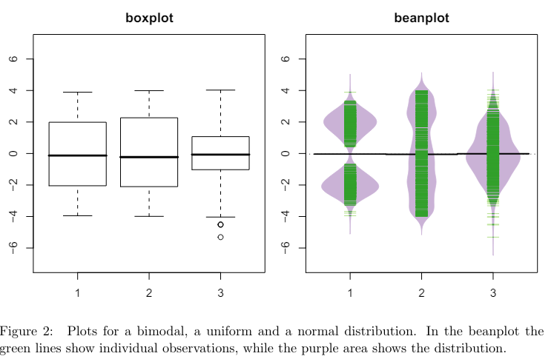
https://www.jstatsoft.org/article/view/v028c01
Notes:
https://www.jstatsoft.org/article/view/v028c01

Slide 36
 | Boxplot | Violin plot | Bean plot
Syntax | Ggplot(data, aes(x = <CATEGORICAL_VAR>, y = <CONTINUOUS_VAR>)) + geom_boxplot() | Ggplot(data, aes(x = <CATEGORICAL_VAR>, y = <CONTINUOUS_VAR>)) + geom_violin() | Install.packages(“Beanplot) beanplot(y ~ x, data = your_data, ...)
Advantage | Summary statistics, outliers detection Easy visual comparison of multiple datasets or groups. | Like boxplot Easy to read Can show true distribution of data Data do not conform to normal distribution
Disadvantage | Less detail Not used for visualizing relationships or patterns between multiple variables. | Harder to interpret than other simpler plots like boxplots or histograms. The mirrored density plot can be confusing.
Notes:
Combine to identify true distribution of data
Using a combination of graphical tools we can perform efficient exploratory analysis and get deeper insights about the distribution of our data.
https://www.quora.com/What-are-the-advantages-and-disadvantages-of-histograms-and-box-plots
https://blog.bioturing.com/2018/05/22/more-on-how-to-compare-box-plots/
12
Boxplots were really designed for normal data, or at least unimodal data. The Beanplot shows you the actual density curve, which is more informative.

Slide 37
SCATTER PLOT

Slide 38
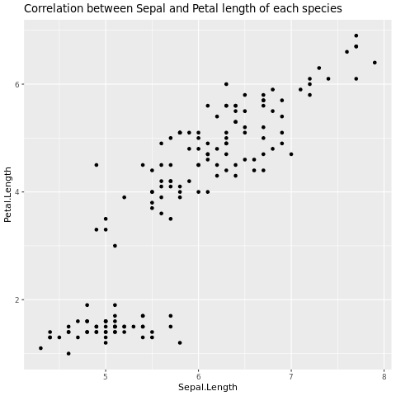
Components and Interpret a Scatter Plot

Slide 39
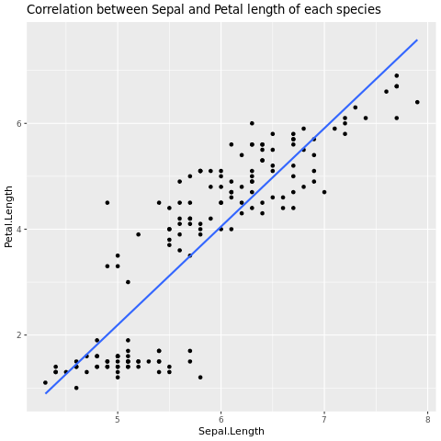
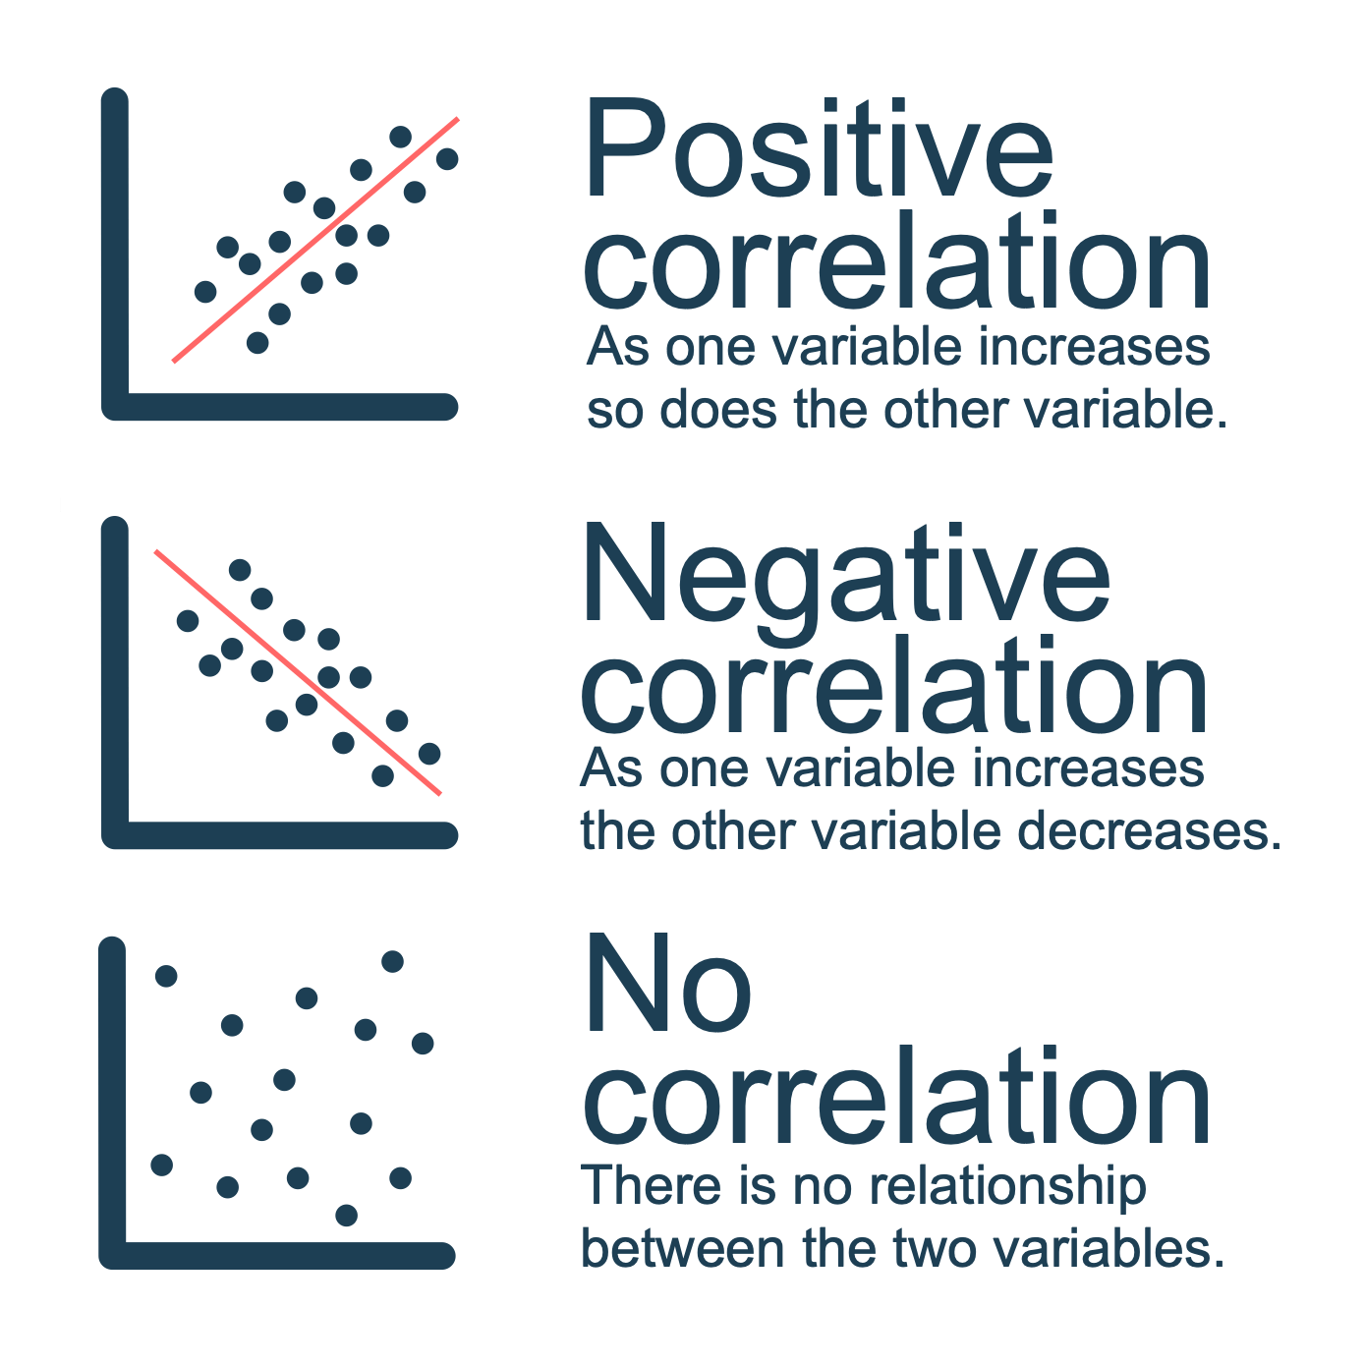
Components and Interpret a Scatter Plot
https://www.internetgeography.net/scatter-graphs-in-geography/
Notes:
ggplot(iris,aes(x=Sepal.Length,y=Petal.Length,color=Species))+geom_point()+labs(title="Correlation between Sepal and Petal length of each species")+geom_smooth(method ="lm", se = FALSE)
by adding a trend line.
Categorical third variable

Slide 40
Components and Interpret a Scatter Plot
Notes:
ggplot(iris,aes(x=Sepal.Length,y=Petal.Length,color=Species))+geom_point()+labs(title="Correlation between Sepal and Petal length of each species")+geom_smooth(method ="lm", se = FALSE)
by adding a trend line.
Categorical third variable

Slide 41
Advantages
easy to create and understand
identify patterns or relationships between variables
identify correlation
Notes:
Barplot cho biết mean và SD
https://www.labxchange.org/library/items/lb:LabXchange:e034541a:html:1

Slide 42
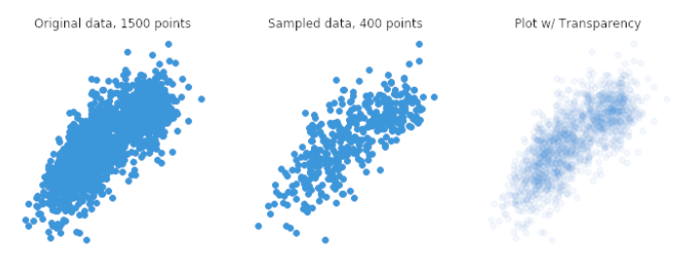
Disadvantages
plots can become cluttered with a large number of data points, making it difficult to interpret the plot.
Overplotting: data points overlap to a degree where we have difficulty seeing relationships between points and variables.
Notes:
Overplotting: With large datasets, scatterplots can suffer from overplotting, where data points overlap and make it difficult to distinguish individual points, especially if they have similar values.

Slide 43
Take home messages

Slide 44
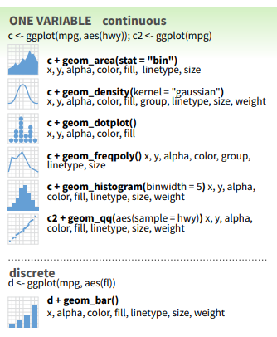
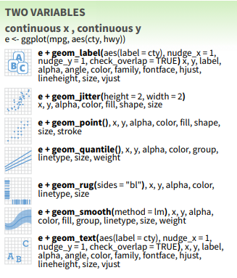
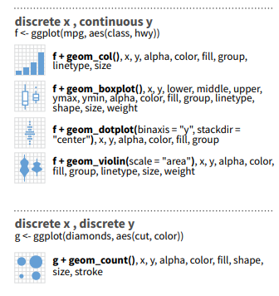
ggplot2 is an R package for producing statistical, or data, graphics.
easy to learn with basic syntax: ggplppt(data,aes(x,y))
Use appropriate plot with type of data
Notes:
aes(), describing how variables in the data are mapped to visual properties (aesthetics) of the plot, such as x and y coordinates, colors, shapes, etc.
bổ sung thêm hình vào các slide, chia ra

Slide 45
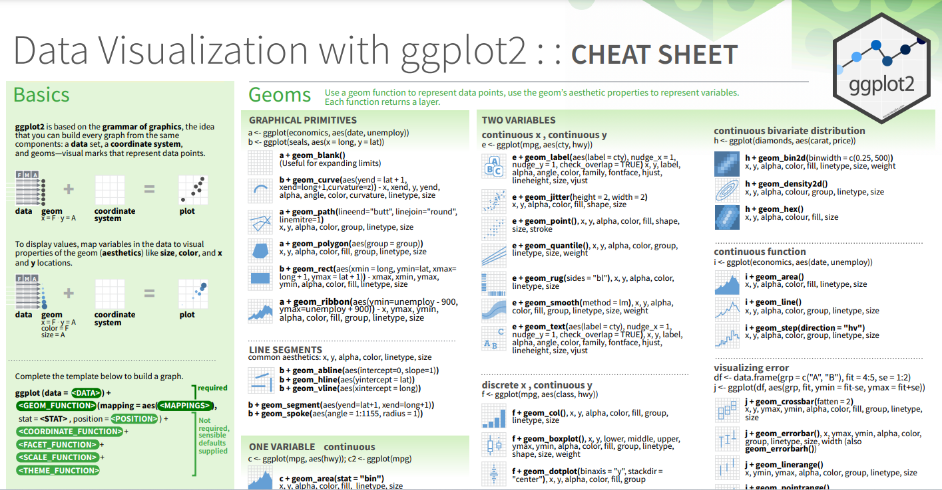
https://www.maths.usyd.edu.au/u/UG/SM/STAT3022/r/current/Misc/data-visualization-2.1.pdf

Slide 46
Thanks for your listening

